Slide 1


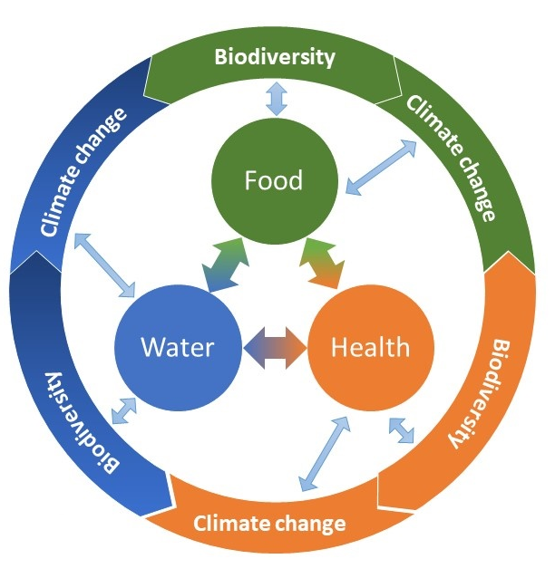

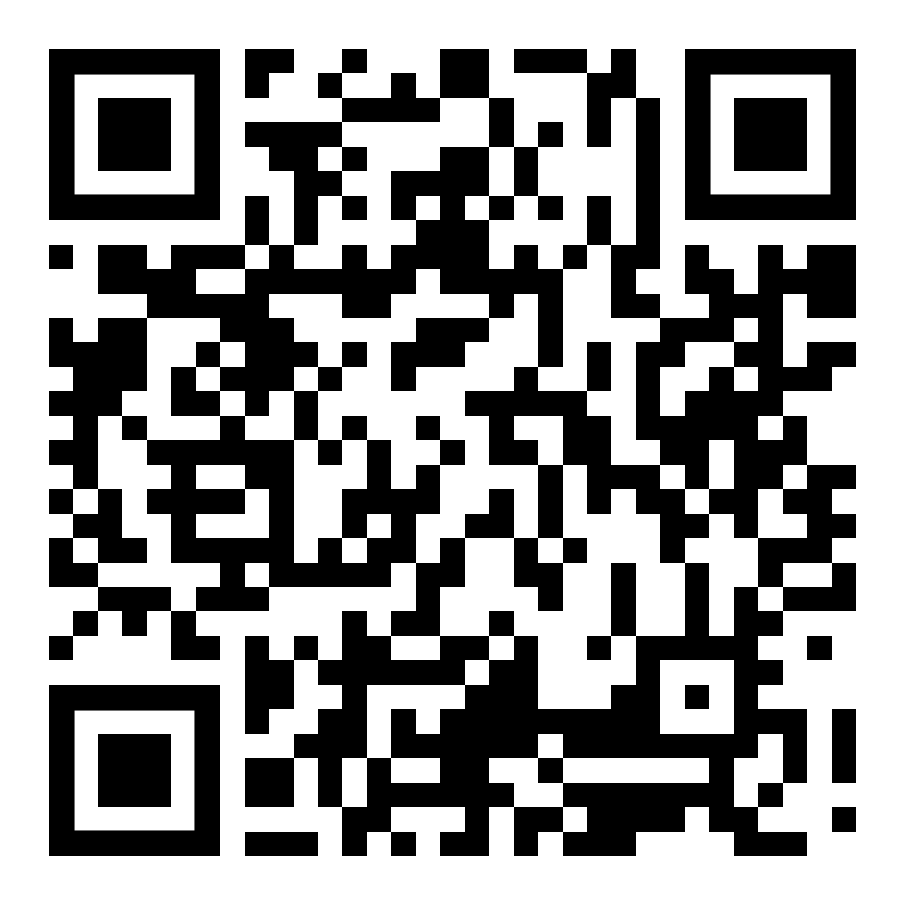
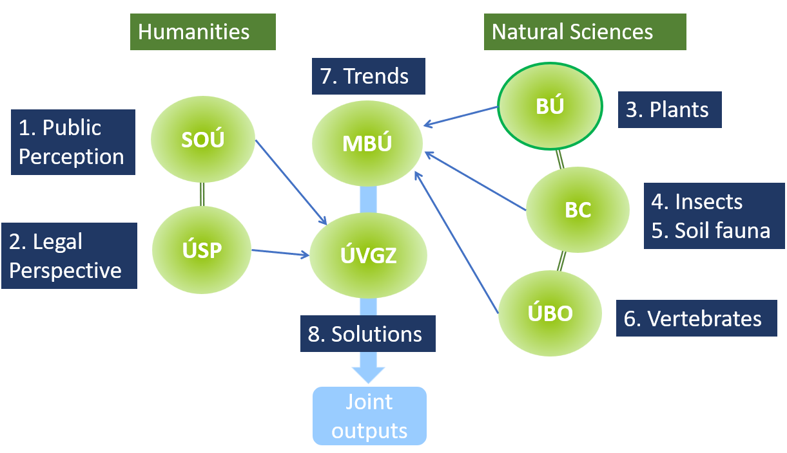
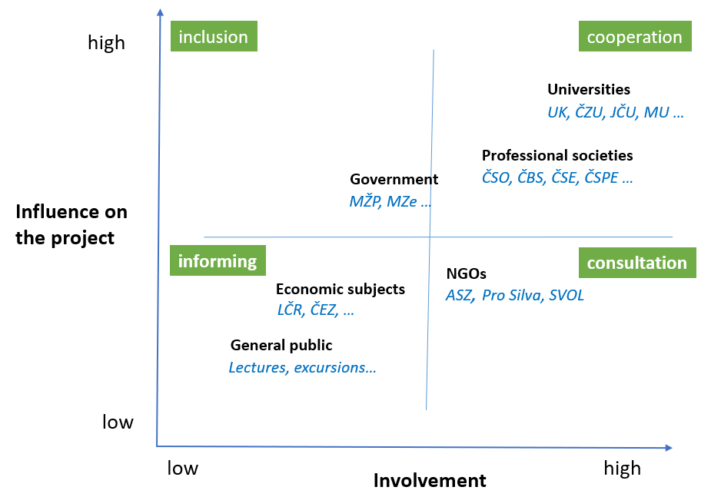
What Jerome tells us:
Long-term changes in the temperate forest vegetation of the Czech Republic
Focus on biodiversity crisis:
Introducing a new research program of the Czech Academy of Sciences
Radim Hédl, Markéta Chudomelová, Petr Petřík, Peter Tkáč and Ondřej Vild
Czech Academy of Sciences, Institute of Botany
Radim Hédl, Institute of Botany, Czech Academy of Sciences
Biodiversity as a Prerequisite for Quality of Life
Our vision
The global biodiversity crisis is without doubt the most serious current environmental threat, together with climate change.
Czech policy and state administration are now actively responding to EU environmental legislation, specifically the Biodiversity Strategy for 2030 and its implementation. Clear communication of the topic to the public will require closer cooperation.
The core vision of the new research program (2026-2030) is to establish a communication platform connecting researchers, government, and the civic society.
Our goal is to embrace the initiative, consolidate the fragmented communication, and bring the topic to the level of public debate.
We want to contribute to identifying effective solutions to biodiversity decline in the context of current societal changes.
The relationship between the state of biodiversity and climate change as prerequisites determining the three fundamental factors of human quality of life.
https://strategie.avcr.cz/programy/krize-biodiverzity
Source: Intergovernmental Science-Policy Platform on Biodiversity and Ecosystem Services
IPBES, Nexus Assessment
Four interrelated objectives
Explore the previously unexamined topic of perceptions of the biodiversity crisis. A sociologically grounded understanding of these perceptions will be essential for targeting communication tools.
Analyze time series on the evolution of biodiversity among key groups of organisms. We will clearly define the main trends and their causes.
Analyze the legal framework for biodiversity conservation. The goal is to support the incorporation of effective legal instruments into Czech legislation.
Integrate approaches and findings from the humanities and natural sciences into a functional whole. We will formulate approaches and concrete steps to address the biodiversity crisis.
The research program emphasizes synthesis arising from collaboration among institutes of the Czech Academy of Sciences with diverse research focuses. All project participants will join forces to prepare four types of joint communication outputs.
Eight topics, eight research institutes of the Czech Academy of Sciences
Public Perception of the Biodiversity Crisis
SOÚ, Jana Stachová
2. The Biodiversity Crisis from a Legal Perspective
ÚSP, Tereza Snopková
3. Plants as the Biological Foundation for Addressing the Biodiversity Crisis
BÚ, Radim Hédl
4. Insect Biodiversity as the Key to Ecosystem Stability
BC - EntÚ, Lukáš Čížek
5. Soil Invertebrates—The Hidden World Beneath Our Feet
BC – ÚPBB, Karel Tajovský
6. The Vertebrate Biodiversity Crisis—Changes Visible to the Public
ÚBO, Jan Zukal
7. Trends in Ecosystem Disturbance and Resilience as a Prerequisite for Biodiversity Restoration
MBÚ, Petr Kohout
8. Addressing the Biodiversity Crisis: The Nexus Between Biodiversity Conservation and Quality of Life
ÚVGZ, Zuzana Harmáčková
Anticipated Stakeholders

